Slide 1

THE BATTLES OF NEIGHBORHOODS
Potential Neighborhood for a New Restaurant, Toronto

Slide 2
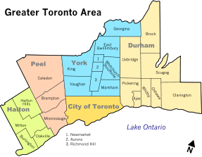

Introduction
Investors need to:
Decide where to open new restaurants in Toronto, Canada.
Know who are the competitors.
Know each neighborhood in Toronto to decide the perfect place.
And to make profit!
Evaluation Criteria:
It has to be a good recommendation in terms of profit and investors expectations.

Slide 3
Data
Data used in this project:
Neighborhood Information (i.e. name, coordinates, populations, income).
Restaurants information (i.e. name, category, coordinates)
Data Sources:
www.foursquare.com
www.toronto.ca

Slide 4
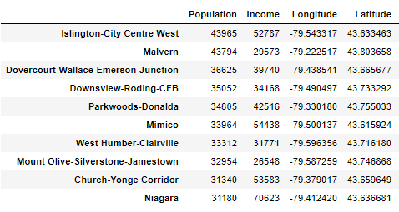
Data Processing
Data cleaning
Data merging between the source codes
Features Extraction

Slide 5
Methodology
Extracting Neighborhoods’ data from Toronto.ca
Retrieving restaurants information per neighborhood from FourSquare API.
Clustering similar neighborhoods based on total scoring using K-Means Clustering
4. Total scoring per neighborhood based on population, income, and number of restaurants.

Slide 6
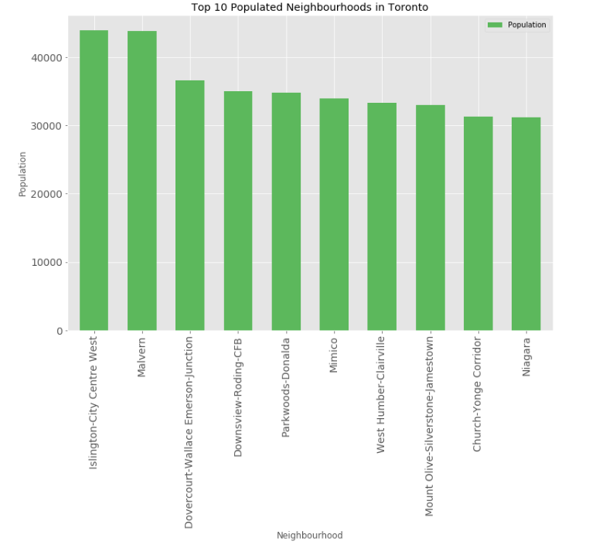
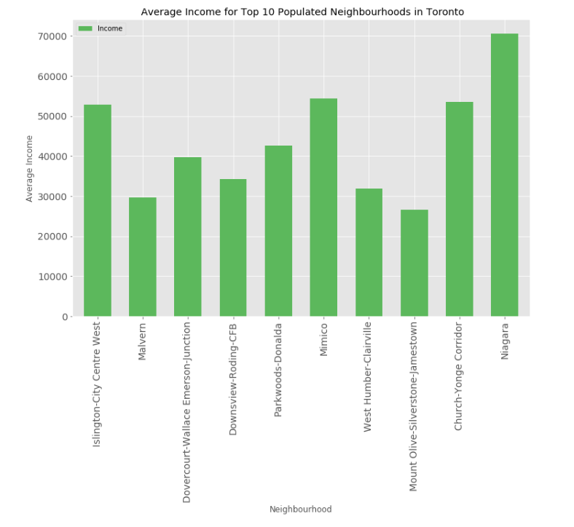
Result (1)
Getting top neighborhoods based on population and comparing their average income.

Slide 7
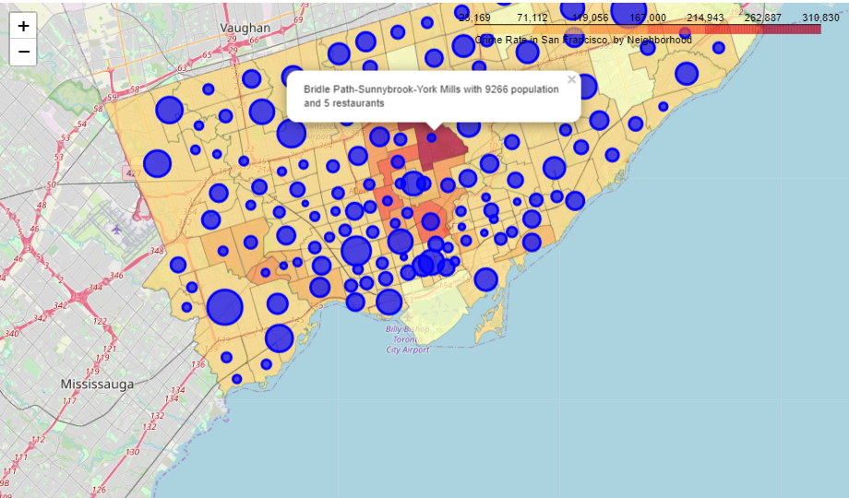
Result (2)
Visualizing population and income for the neighborhoods to be able to compare visually.

Slide 8
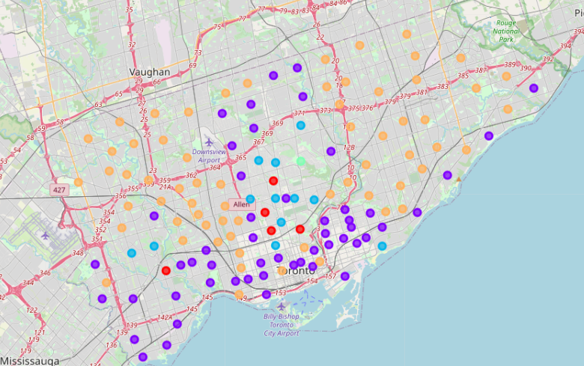
Result (3)
Clustering similar Neighborhoods using the scoring

Slide 9
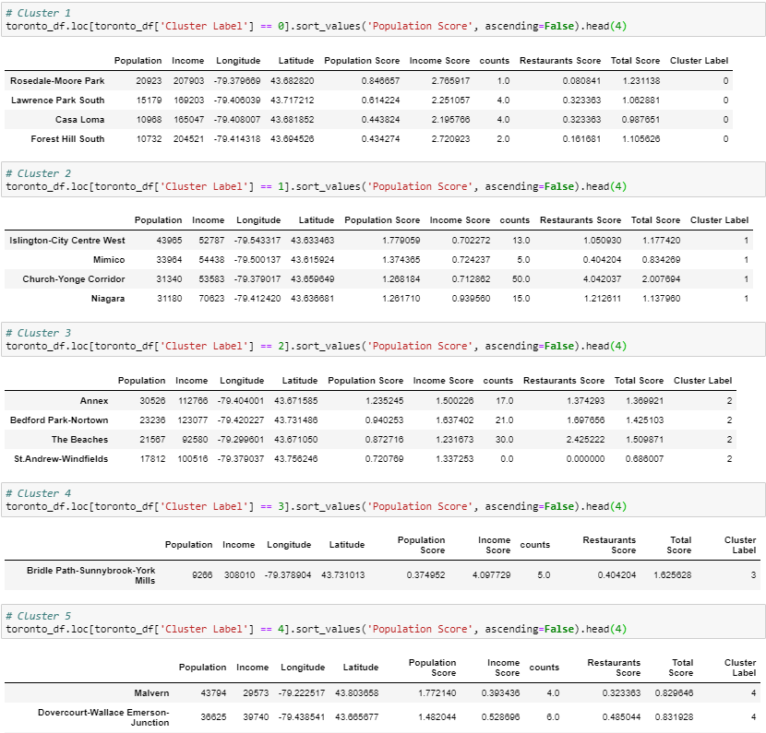
Result (3) – cont.

Slide 10
Discussion (1)
Based on the map of population and income:
the neighborhoods in the middle of Toronto were good choices for the new restaurants as they have high income average and good population.

Slide 11
Discussion (2)
Based on clustering:
The first and fifth clusters ( 0 and 4) had the best potential places as the first one has very low supply (low restaurants number) with average demand (population) and the fifth one has very high demand (high population score) with low restaurants number (low supply).
As we have the average income, it is recommended that the new restaurants focus on high prices menu for the first cluster and low prices menu for the fifth one.

Slide 12
Conclusion
We have concluded that the best potential new restaurant place in Toronto will be either first or fifth cluster as there is average to high demand with low supply (low competitors).

